Slide 1
Data Communications

Slide 2
Go-Back-N ARQ
Based on sliding-window flow control.
Station send a series of frames sequentially numbered modulo some maximum value.
Number of unacknowledged frames outstanding is determined by window size, using the sliding-window flow control technique.
.

Slide 3
Go-Back-N ARQ
no errors :
Destination will acknowledge incoming frames ( or piggybacked acknowledgment).
error
send a negative acknowledgment for that frame.
The destination station will discard that frame and all future incoming frames until the frame in error is correctly received.
The source station, when it receives a REJ, must retransmit the frame in error plus all succeeding frames that were transmitted in the interim.
.

Slide 4
Go-Back-N ARQ
Suppose that station A is sending frames to station B.
After each transmission, A sets an acknowledgment timer for the frame just transmitted.
Suppose that B has previously successfully received frame (i – 1) and A has just transmitted frame i.
The go-back-N technique takes into account the following contingencies:
.

Slide 5
Go-Back-N ARQ
Damaged frame. If the received frame is invalid (i.e., B detects an error ), B discards the frame. There are two subcases:
  Within a reasonable period of time, A subsequently sends
  frame ,B receives frame out of order and sends a
  REJ i. A must retransmit frame i and all subsequent frames.
  A does not soon send additional frames. B receives nothing and returns neither an RR nor a REJ. When A’s timer expires, it transmits an RR frame that includes a bit known as the P bit, which is set to 1. B interprets the RR frame with a P bit of 1 as a command that must be acknowledged by sending an RR indicating the next frame that it expects, which is frame i. When A receives the RR, it retransmits frame i. Alternatively, A could just retransmit frame i when its timer expires.
.

Slide 6
Go-Back-N ARQ
2. Damaged RR. There are two subcases:
B receives frame i and sends RR (i+1) which suffers an error in transit. Because acknowledgments are cumulative (e.g., RR 6 means that all frames through 5 are acknowledged), it may be that A will receive a subsequent RR to a subsequent frame and that it will arrive before the timer associated with frame i expires.
If A’s timer expires, it transmits an RR command as in Case 1b. It sets another timer, called the P-bit timer. If B fails to respond to the RR command, or if its response suffers an error in transit, then A’s P-bit timer will expire. At this point, A will try again by issuing a new RR command and restarting the P-bit timer. This procedure is tried for a number of iterations. If A fails to obtain an acknowledgment after some maximum number of attempts, it initiates a reset procedure.
3. Damaged REJ. If a REJ is lost, this is equivalent to Case 1b.
.

Slide 7
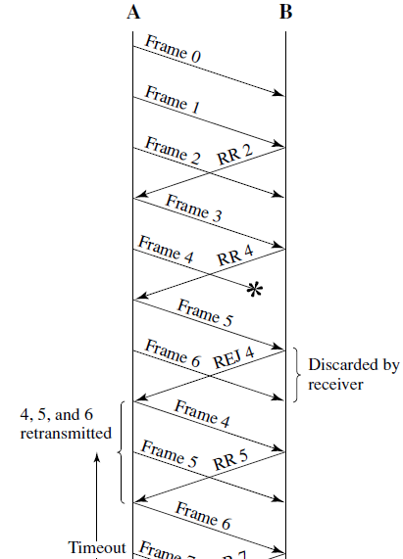
Go-Back-N ARQ
Here, frame 4 is damaged.
Frames 5 and 6 are received out of order and are discarded by B.
When frame 5 arrives, B immediately sends a REJ 4.
When the REJ to frame 4 is received, not only frame 4 but frames 5 and 6 must be retransmitted.
The transmitter must keep a copy of all unacknowledged frames.
.

Slide 8
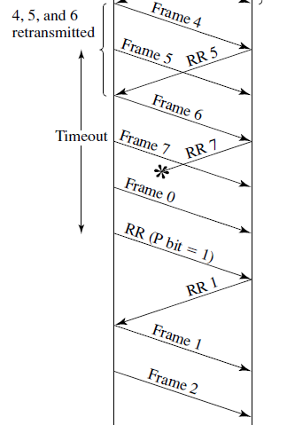
Go-Back-N ARQ
Example of retransmission after timeout.
No acknowledgment is received for frame 5 within the timeout period, so A issues an RR to determine the status of B.
.

Slide 9
Go-Back-N ARQ
For a k-bit sequence number field, which provides a sequence number range of the maximum sender window size is
.

Slide 10
Go-Back-N ARQ
Assume a 3-bit sequence number (sequence number ).
Suppose a station sends frame 0 and gets back an RR 1 and
then sends frames 1, 2, 3, 4, 5, 6, 7, 0 and gets another RR 1.
This could mean that all eight frames were received correctly and the RR 1 is a cumulative acknowledgment.
It could also mean that all eight frames were damaged or lost in transit, and the receiving station is repeating its previous RR 1.
The problem is avoided if the maximum window size is limited to
.

Slide 11
Go-Back-N ARQ
For a k-bit sequence number field, which provides a sequence number range of the maximum sender window size is limited to
Receiver window size is 1.
.

Slide 12
Selective-Reject ARQ
With selective-reject ARQ, the only frames retransmitted are those that receive a
negative acknowledgment, in this case called SREJ, or those that time out.
.

Slide 13
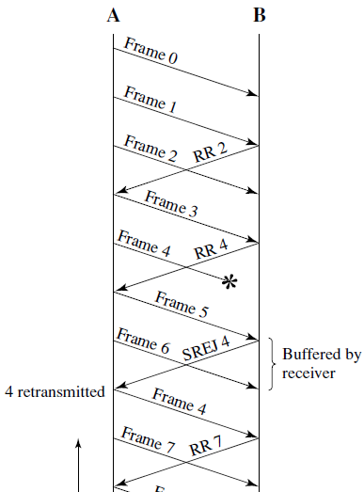
Selective-Reject ARQ
When frame 5 is received out of order, B sends a SREJ 4, indicating that frame 4 has not been received.
However, B continues to accept incoming frames and buffers them until a valid frame 4 is received.
At that point, B can place the frames in the proper order for delivery to higher-layer software.
.

Slide 14
Selective-Reject ARQ
Selective reject would appear to be more efficient than go-back-N, because it minimizes the amount of retransmission.
On the other hand, the receiver :
  must maintain a buffer large enough to save post-SREJ frames until the frame in error is retransmitted and
  must contain logic for reinserting that frame in the proper sequence.
The transmitter, too,
  requires more complex logic to be able to send a frame out of sequence.
.

Slide 15
Selective-Reject ARQ
Because of such complications, select-reject ARQ is much less widely used than go-back-N ARQ.
Selective reject is a useful choice for a satellite link because of the long propagation delay involved.
.

Slide 16
Selective-Reject ARQ
Window size limitation is more restrictive for selective-reject than for goback-N.
.

Slide 17
Selective-Reject ARQ
Consider the case of a 3-bit sequence number.
Allow a window size of seven, and consider the following scenario:
Station A sends frames 0 through 6 to station B.
Station B receives all seven frames and cumulatively acknowledges with RR 7.
Assume the RR 7 is lost.
A times out and retransmits frame 0.
B has already advanced its receive window to accept frames 7, 0, 1, 2, 3, 4, and 5.
Thus it assumes that frame 7 has been lost and that this is a new frame 0,
which it accepts.
.

Slide 18
Selective-Reject ARQ
To overcome the problem, the maximum window size should be no more than half the range of sequence numbers.
In general, for a k-bit sequence number field, which provides a sequence number range of 2^{k}, the maximum window size is limited to 2^{k-1}.
.

Slide 19
END
.

